Slide 1
Investigating a Steam Dataset
Student: Conor McCauley
Supervisor: Prof. Doug Leith

Slide 2
The Steam Platform
Video game distribution platform
Largest of its kind on PC
60 thousand games
120 million monthly users
Games purchased and launched from the desktop app
Users can review games they’ve played
Binary rating (‘thumbs up’ or ‘thumbs down’)
Written review

Slide 3
The Steam Platform
Social network functionality
Add other users as friends
‘Community Hubs’ for games
User groups

Slide 4
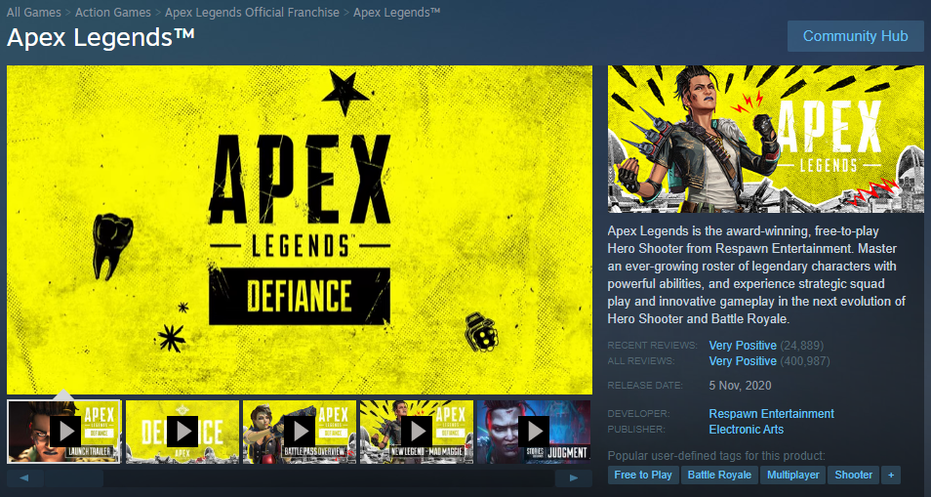
Steam: store Page

Slide 5
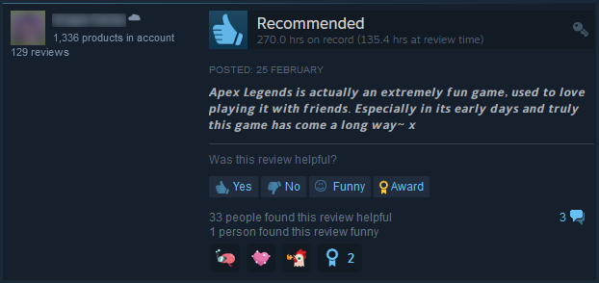
Steam: Game Review

Slide 6
The Dataset
Scraped from Steam
Data for 4 million users
Friends
Group membership
Reviews written

Slide 7
The Dataset
Reviews written:
Rating (thumbs up/down)
Text (multiple languages)
Timestamp
Playtime (‘at review’/‘total’)
Votes (helpful/funny)

Slide 8
Research Approaches
Relationship between review text and other features
Relationship between a game’s early reviews and future success
Influenced behaviour among users and particularly influential users

Slide 9
Approach I
Relationship between review text and …
Rating
Playtime
Votes
Can the review text predict these features?
Use BERT to vectorise the text for training a deep learning model
Use as classifier (rating) or regressor (votes)

Slide 10
Approach I
BERT:
State-of-the-art technique in NLP
Maps tokens in text to vectors
Accounts for context of words
Fine-tune pre-trained model(s) on our dataset
Use TF-IDF as a baseline vectoriser
Use Naive Bayes, SGD as baseline classifiers/regressors

Slide 11
Approach II
Relationship between early reviews and future success
How to determine success?
Number of players (reviews)
Playtime
Percentage of positive ratings
BERT used for text vectorisation

Slide 12
Approach III
Influenced behaviour among users and particularly influential users
Determine potentially influenced behaviours:
User reviews a game that a friend already reviewed
Can influenced behaviours be predicted?
Can we use the wider social graph to find “influencers”?

Slide 13

Any Questions?

